Slide 1

Relations
And
Functions

Slide 2
A relation is a set of ordered pairs.
The domain is the set of all x values in the relation
domain = {-1,0,2,4,9}
These are the x values written in a set from smallest to largest
This is a relation
{(2,3), (-1,5), (4,-2), (9,9), (0,-6)}
{(2,3), (-1,5), (4,-2), (9,9), (0,-6)}
{(2,3), (-1,5), (4,-2), (9,9), (0,-6)}
These are the y values written in a set from smallest to largest
range = {-6,-2,3,5,9}
The range is the set of all y values in the relation

Slide 3
A relation assigns the x’s with y’s
1
2
2
4
3
6
4
8
5
10
Domain (set of all x’s)
Range (set of all y’s)
This relation can be written {(1,6), (2,2), (3,4), (4,8), (5,10)}

Slide 4


A function f from set A to set B is a rule of correspondence that assigns to each element x in the set A exactly one element y in the set B.
A function f from set A to set B is a rule of correspondence that assigns to each element x in the set A exactly one element y in the set B.
A function f from set A to set B is a rule of correspondence that assigns to each element x in the set A exactly one element y in the set B.
1
2
No x has more than one y assigned
All x’s are assigned
2
4
3
6
4
8
5
10
Set A is the domain
Set B is the range
Whew! What did that say?
This is a function ---it meets our conditions
Must use all the x’s
The x value can only be assigned to one y

Slide 5
Let’s look at another relation and decide if it is a function.
The second condition says each x can have only one y, but it CAN be the same y as another x gets assigned to.
1
2
No x has more than one y assigned
All x’s are assigned
2
4
3
6
4
8
5
10
Set A is the domain
Set B is the range
This is a function ---it meets our conditions
Must use all the x’s
The x value can only be assigned to one y

Slide 6
A good example that you can “relate” to is students in our maths class this semester are set A. The grade they earn out of the class is set B. Each student must be assigned a grade and can only be assigned ONE grade, but more than one student can get the same grade (we hope so---we want lots of A’s). The example show on the previous screen had each student getting the same grade. That’s okay.
A good example that you can “relate” to is students in our maths class this semester are set A. The grade they earn out of the class is set B. Each student must be assigned a grade and can only be assigned ONE grade, but more than one student can get the same grade (we hope so---we want lots of A’s). The example shown on the previous screen had each student getting the same grade. That’s okay.
1
2
2
4
3
6
4
8
5
10
2 was assigned both 4 and 10
Is the relation shown above a function?
NO
Why not???

Slide 7
Check this relation out to determine if it is a function.
It is not---3 didn’t get assigned to anything
Comparing to our example, a student in maths must receive a grade
1
2
2
4
3
6
4
8
5
10
Set A is the domain
Set B is the range
This is not a function---it doesn’t assign each x with a y
Must use all the x’s
The x value can only be assigned to one y

Slide 8
Check this relation out to determine if it is a function.
This is fine—each student gets only one grade. More than one can get an A and I don’t have to give any D’s (so all y’s don’t need to be used).
1
2
2
4
3
6
4
8
5
10
Set A is the domain
Set B is the range
This is a function
Must use all the x’s
The x value can only be assigned to one y

Slide 9
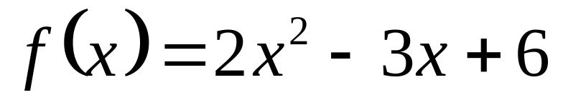
Function Notation
We commonly call functions by letters. Because function starts with f, it is a commonly used letter to refer to functions.
This means the right hand side is a function called f
The left side DOES NOT MEAN f times x like brackets usually do, it simply tells us what is on the right hand side.
This means the right hand side has the variable x in it
The left hand side of this equation is the function notation. It tells us two things. We called the function f and the variable in the function is x.

Slide 10
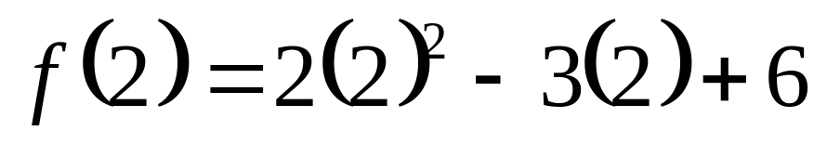
Remember---this tells you what is on the right hand side---it is not something you work. It says that the right hand side is the function f and it has x in it.
So we have a function called f that has the variable x in it.
Using function notation we could then ask the following:
This means to find the function f and instead of having an x in it, put a 2 in it. So let’s take the function above and make brackets everywhere the x was and in its place, put in a 2.
Find f (2).
Don’t forget order of operations---powers, then multiplication, finally addition & subtraction

Slide 11
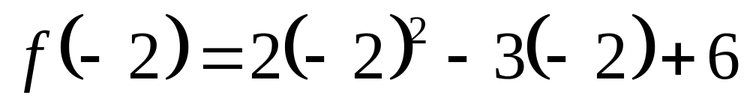
Find f (-2).
This means to find the function f and instead of having an x in it, put a -2 in it. So let’s take the function above and make brackets everywhere the x was and in its place, put in a -2.
Don’t forget order of operations---powers, then multiplication, finally addition & subtraction

Slide 12
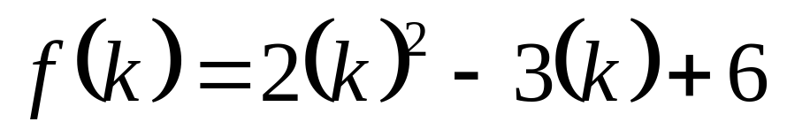
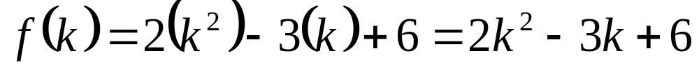
Find f (k).
This means to find the function f and instead of having an x in it, put a k in it. So let’s take the function above and make brackets everywhere the x was and in its place, put in a k.
Don’t forget order of operations---powers, then multiplication, finally addition & subtraction

Slide 13
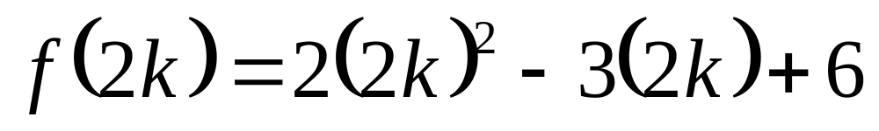
Find f (2k).
This means to find the function f and instead of having an x in it, put a 2k in it. So let’s take the function above and make brackets everywhere the x was and in its place, put in a 2k.
Don’t forget order of operations---powers, then multiplication, finally addition & subtraction

Slide 14
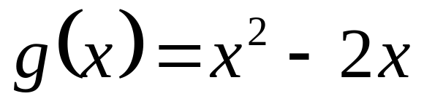
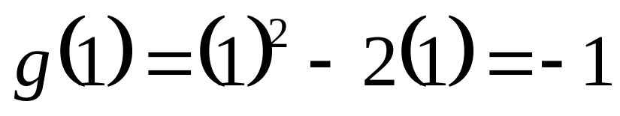
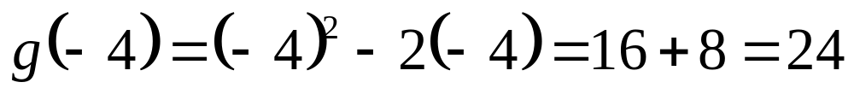
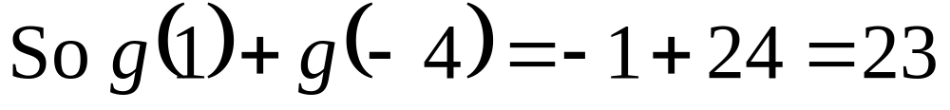
Let's try a new function
Find g(1)+ g(-4).

Slide 15
The last thing we need to learn about functions for this section is something about their domain. Recall domain meant "Set A" which is the set of values you plug in for x.
For the functions we will be dealing with, there are two "illegals":
You can't divide by zero (denominator (bottom) of a fraction can't be zero)
You can't take the square root (or even root) of a negative number
When you are asked to find the domain of a function, you can use any value for x as long as the value won't create an "illegal" situation.

Slide 16
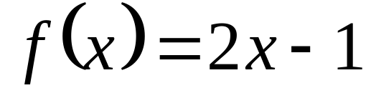
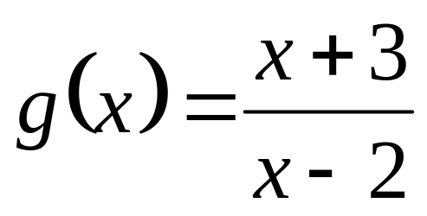
Find the domain for the following functions:
Since no matter what value you choose for x, you won't be dividing by zero or square rooting a negative number, you can use anything you want so we say the answer is: All real numbers x.
Note: There is nothing wrong with the top = 0 just means the fraction = 0
If you choose x = 2, the denominator will be 2 – 2 = 0 which is illegal because you can't divide by zero. The answer then is: All real numbers x such that x ≠ 2.
illegal if this is zero
means does not equal

Slide 17
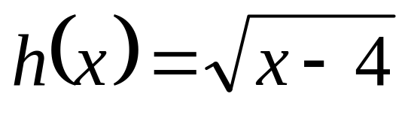
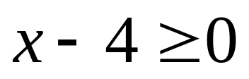
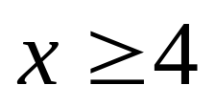
Let's find the domain of another one:
Can't be negative so must be ≥ 0
solve this
We have to be careful what x's we use so that the second "illegal" of square rooting a negative doesn't happen. This means the "stuff" under the square root must be greater than or equal to zero (maths way of saying "not negative").
So the answer is:
All real numbers x such that x ≠ 4

Slide 18
Summary of How to Find the Domain of a Function
Look for any fractions or square roots that could cause one of the two "illegals" to happen. If there aren't any, then the domain is All real numbers x.
If there are fractions, figure out what values would make the bottom equal zero and those are the values you can't use. The answer would be: All real numbers x such that x ≠ those values.
If there is a square root, the "stuff" under the square root cannot be negative so set the stuff ≥ 0 and solve. Then answer would be: All real numbers x such that x ≠ whatever you got when you solved.
NOTE: Of course your variable doesn't have to be x, can be whatever is in the problem.

Slide 19
Acknowledgement
I wish to thank Shawna Haider from Salt Lake Community College, Utah USA for her hard work in creating this PowerPoint.
www.slcc.edu
Shawna has kindly given permission for this resource to be downloaded from www.mathxtc.com and for it to be modified to suit the Western Australian Mathematics Curriculum.
Stephen Corcoran
Head of Mathematics
St Stephen’s School – Carramar
www.ststephens.wa.edu.au

